Slide 1
Strategy Pattern

Slide 2
Agenda
What is a Strategy Pattern
Problem Example
How strategy resolves the problem
Structure
Code
When is it applicable to implement this pattern
How to Implement
Other Example Uses
Pros and Cons

Slide 3
What is a Strategy Pattern
Strategy pattern is a behavioral software design pattern that enables a behavior (an algorithm) to be selected at runtime.
A Strategy defines a set of algorithms that can be used interchangeably.
Notes:
Behavioral Pattern – Patterns that are concerned with algorithms and the assignment of responsibilities between objects.

Slide 4

Problem Example
Navigation App created for casual travelers
Automatic route planning that finds the fastest route to a destination
First version of app was successful – Only useful for vehicle
Next updates added routes for walking, public transportation, cycling.
Code base cause headaches – large main class
Changes increased chances of error
Teamwork became difficult

Slide 5
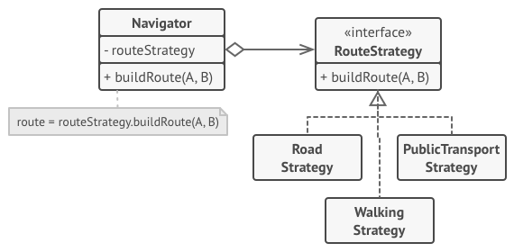
Solution
Strategy pattern – extracting to smaller algorithms
Context class – has reference to one of the strategies
Context class isn’t responsible for selecting algorithm
Works with all strategies through generic interface
Each route strategy is extracted to its own class
Parameters are the same, return different results
Navigator class has method for switching active route
User decides on their selected route behavior

Slide 6
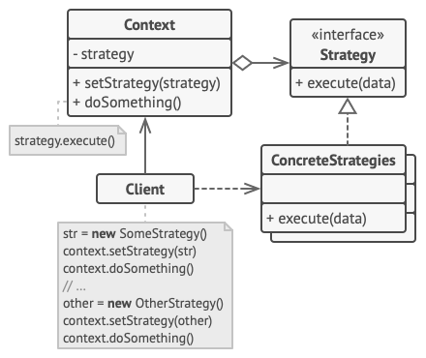
Structure
Context - maintains reference to one of the concrete strategies.
Strategy - interface is common to all concrete strategies.
Concrete Strategies - different variations algorithms the context uses.
Context calls the execute method strategy object each time it needs to run an algorithm.
Client - creates strategy object and passes it to the context.

Slide 7
Code Time

Slide 8
When is this Applicable
You want to use different variants of an algorithm within an object and be able to switch from one algorithm to another during runtime.
You have a lot of similar classes that only differ in the way they execute some behavior.
To isolate the business logic of a class from the implementation details of algorithms that may not be as important in the context of that logic.
Your class has a massive conditional operator that switches between different variants of the same algorithm.

Slide 9
How to Implement
In context class, identify an algorithm that’s prone to frequent changes.
Declare the strategy interface common to all the algorithms.
Extract all algorithms into their own classes one by one.
In context class, add a field for storing a reference to a strategy object. Provide a setter for replacing values of that field.
Clients of the context must associate it with a suitable strategy that matches the way they expect the context to perform its primary job.

Slide 10
Other Example Uses
File Encryption – Different ways of encryption depending on scenario
File Compression - Different ways to compress: ZIP, Rar, Tar.gz, 7z
File Types - Saving to Different File Types
Validation – Different Types of Validations
Sorting Algorithms – Different Types of Sorting Algorithms

Slide 11
Pros and Cons
Pros
You can swap algorithms used inside an object at runtime.
You can isolate the implementation details of an algorithm from the code that uses it.
You can replace inheritance with composition.
Open/Closed Principle. You can introduce new strategies without having to change the context.
Cons
If you only have a couple of algorithms and they rarely change, there’s no real reason to overcomplicate the program with new classes and interfaces that come along with the pattern.
Clients must be aware of the differences between strategies to be able to select a proper one.

Slide 12

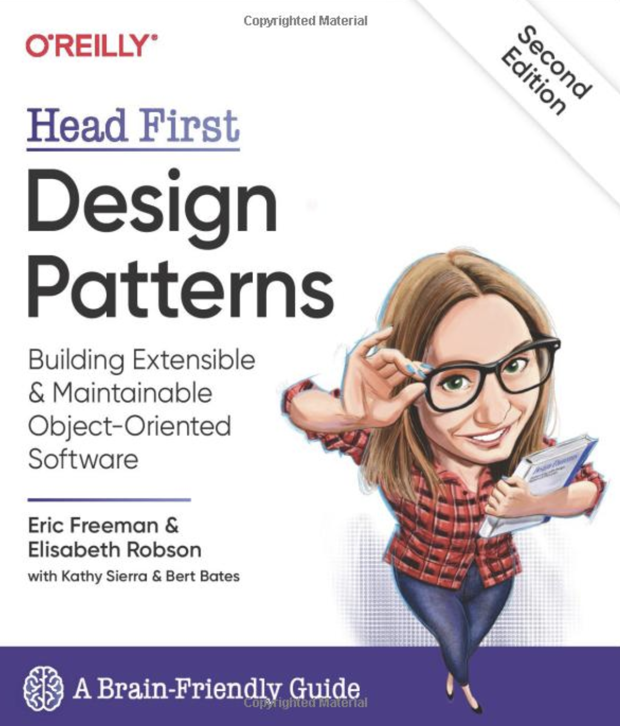
References
https://refactoring.guru/design-patterns/strategy
https://www.oreilly.com/library/view/head-first-design/9781492077992/

